Slide 1
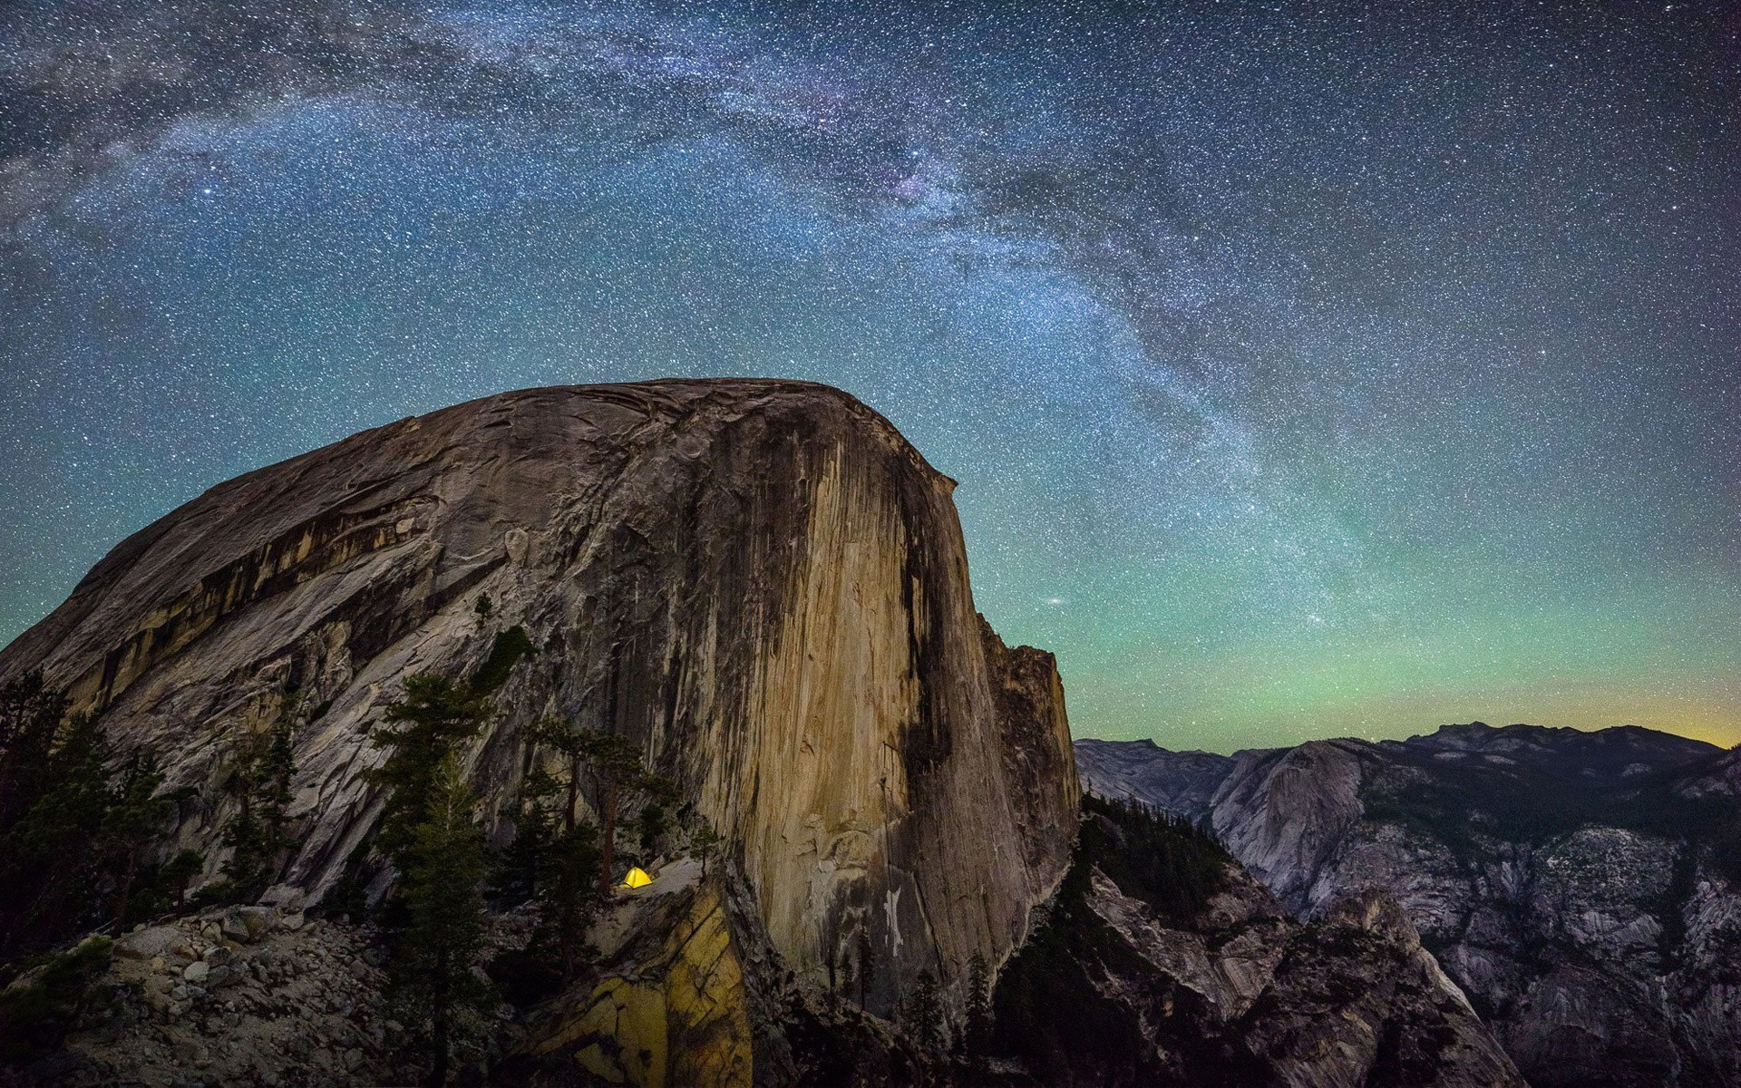
Enhancing the contrast in Hubble images of post-AGB stars
David Martin
Undergraduate Researcher
Steward Observatory / The University of Arizona
D. Martin, S. Ertel, G. Schneider, D. Kamath, E. Choquet
David Martin - University of Arizona
davidmartin@email.arizona.edu

Slide 2
Why do we care?
David Martin - University of Arizona
davidmartin@email.arizona.edu

Slide 3
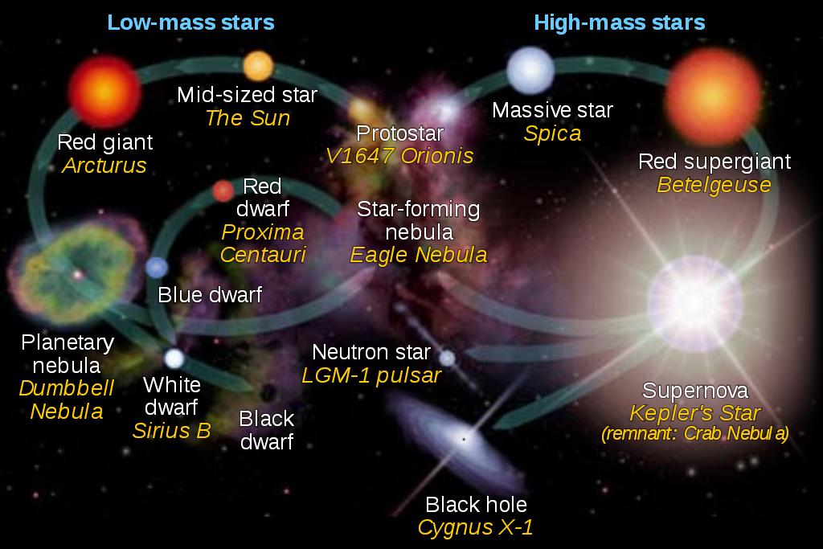
Studying the structures of post-AGB envelopes is critical to understanding the late post-main sequence evolution of low and intermediate mass stars.
David Martin - University of Arizona
davidmartin@email.arizona.edu

Slide 4
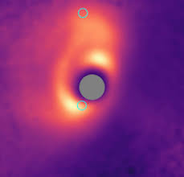
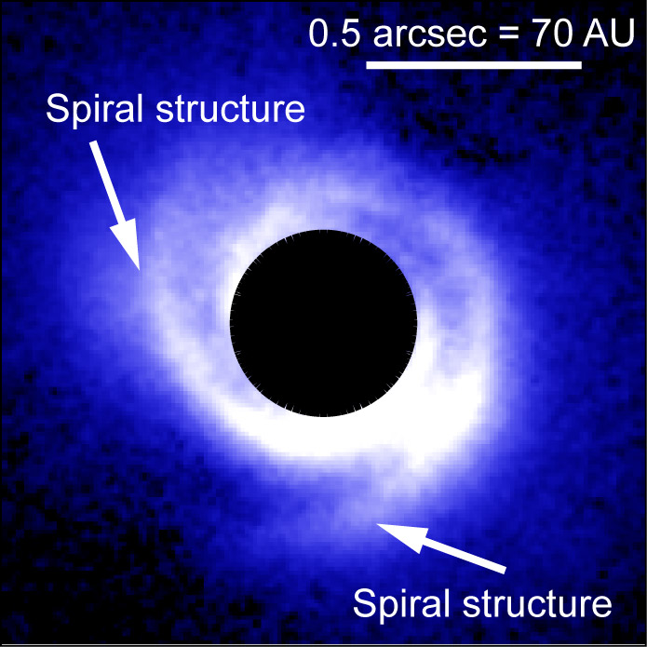
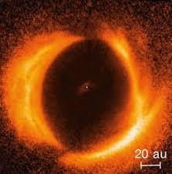
The contrast between star and circumstellar emission makes imaging faint, low mass envelopes and structures close to the star difficult.
David Martin - University of Arizona
davidmartin@email.arizona.edu

Slide 5
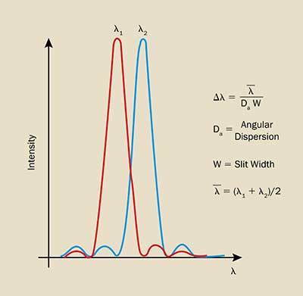
We use reference star point spread function subtraction developed for other science cases to remove the bright star light from archival Hubble images of post-AGB stars in order to enhance their contrasts.
David Martin - University of Arizona
davidmartin@email.arizona.edu

Slide 6
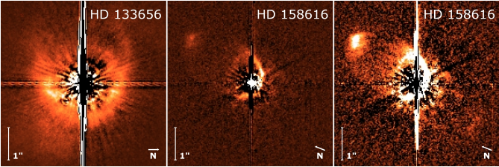
In this pioneer study, we have demonstrated the effectiveness of the method for archival images of post-AGB stars and discovered previously undetected circumstellar emission around two stars.
David Martin - University of Arizona
davidmartin@email.arizona.edu

Slide 7
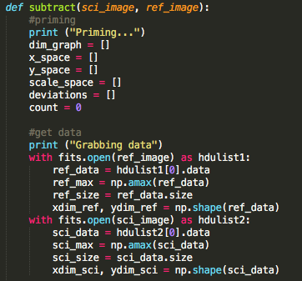
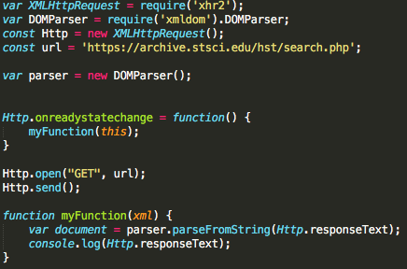
This makes the method a powerful tool to image circumstellar envelopes that are more compact or fainter than those previously studied and we will now develop the tools to efficiently and systematically analyze all relevant archival Hubble data.
David Martin - University of Arizona
davidmartin@email.arizona.edu

Slide 8
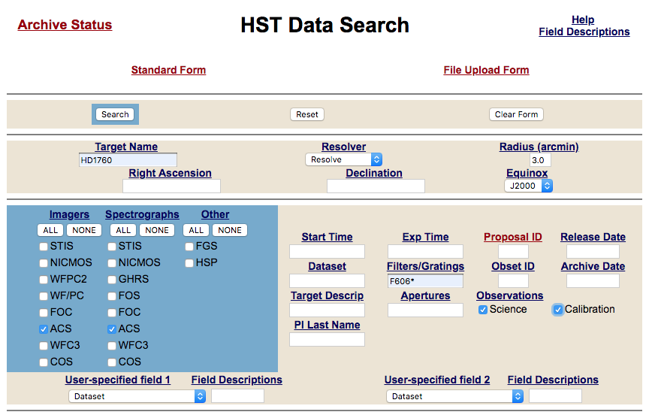
David Martin - University of Arizona
davidmartin@email.arizona.edu

Slide 9
Thank you very much!
Want to know more?
http://iopscience.iop.org/article/10.3847/2515-5172/aaf46f/meta
Link to the proposal here
David Martin - University of Arizona
davidmartin@email.arizona.edu

